Slide 1
Course Name : DevOps
Unit 1 : Introduction to DevOps

Slide 2
List of Content
What Is DevOps
History of DevOps
DevOps definition
DevOps Main Objectives
DevOps and Software Development Life Cycle (Waterfall Model, & Agile Model)
Continuous Integration & Deployment (Jenkins)
Containers and Virtual Development (Docker, Vagrant),
Configuration Management Tools (Ansible, Puppet & Chef)

Slide 3
DevOps Main Objective
Development Team
Operations Team
Deploy
Maintenance
Monitoring
Developer
Build
Test
QA

Slide 4
Introduction to DevOps
The term DevOps is a combination of Two words :
Development & Operations

Slide 5
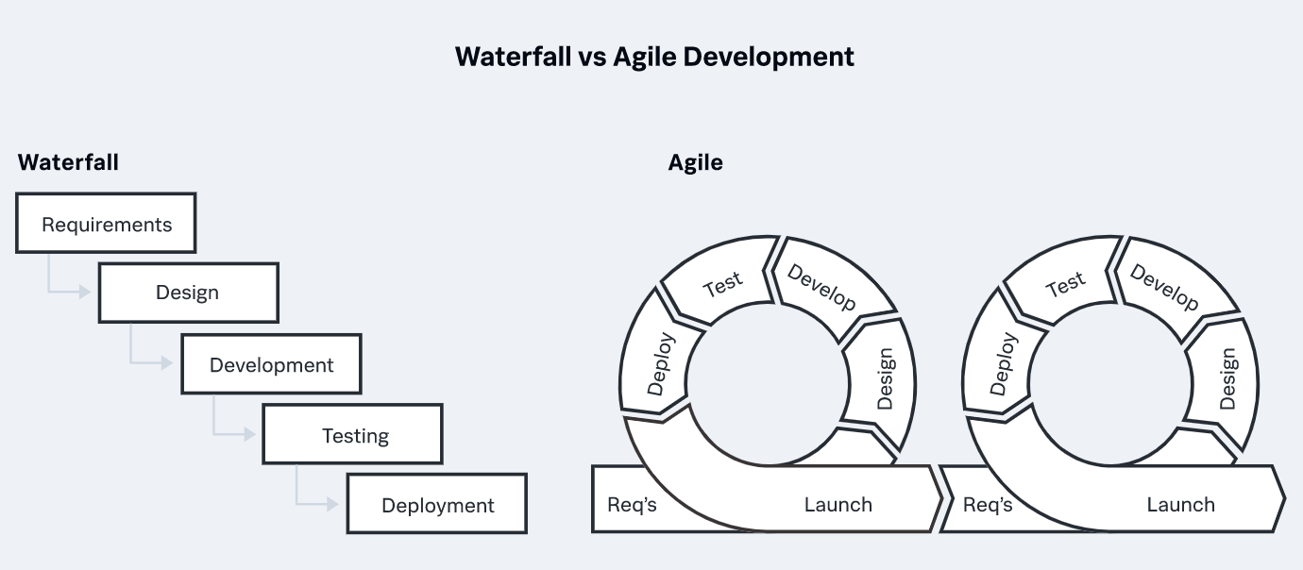
Waterfall and Agile methodology

Slide 6
DevOps Stages
Version
Control
Continuous Integration
Continuous
Delivery
Continuous Deployment

Slide 7
DevOps is a methodology that allows a single term to manage the entire application development life cycle, that is development , testing , deployment and operations.
The objective of DevOps is to shorten the system’s development life cycle.
DevOps is a software development approach through which superior quality software can be developed quickly and with more reliability.

Slide 8


CI/CD Pipeline (Jenkins)
Before CI/CD
INTEGRATION
REPOSITORY
(GIT)
TESTING

Slide 9


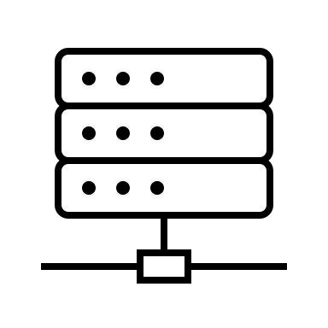
CI/CD Pipeline (Jenkins)
After. CI/CD
Pulled towards CI Server
Source Code
REPOSITORY
(GIT) BUILD TEST DEPLOY
Notify Success/ Failure C I Server

Slide 10
CI/CD PIPELINE

Slide 11
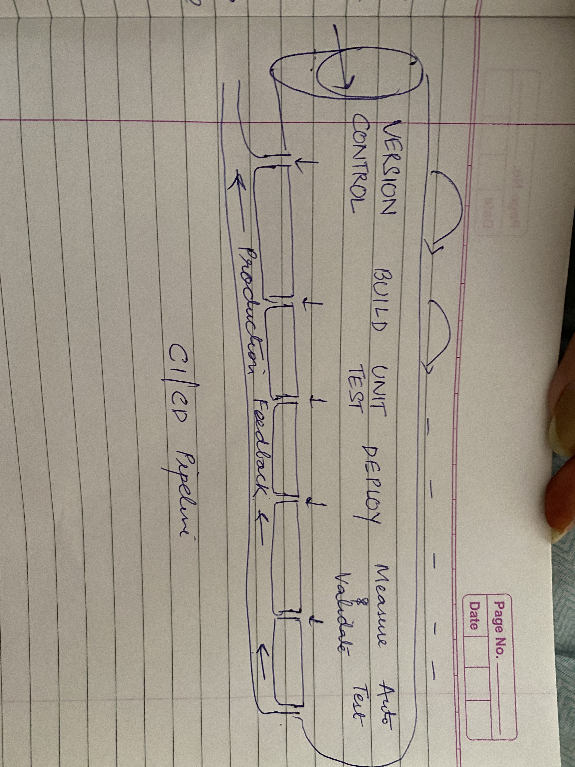
CICD PIPELINE

Slide 12
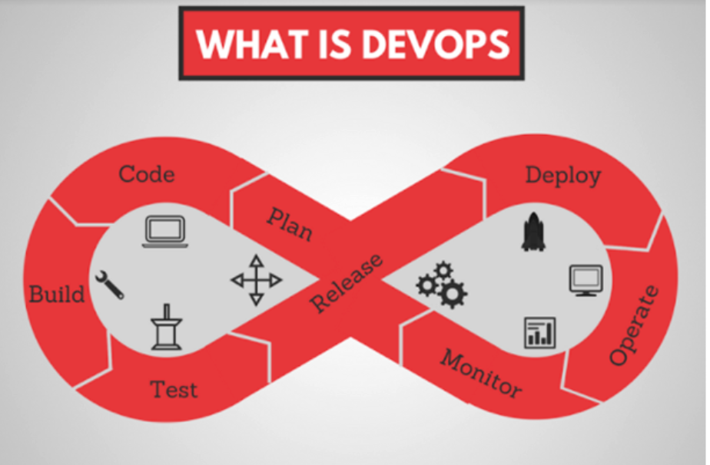

Slide 13
PLAN
CODE
BUILD
TEST
DEPLOY
OPERATE
MONITOR
JENKINS
Integration
Tool

Slide 14
What is Jenkins
Jenkins is an open source project written in Java .
The leading open source automation server.
It helps to perform a chain of actions to achieve the Continuous Integration process in an automated fashion.
For example, if your team is developing a project, Jenkins will continuously test your project builds and show you the errors in early stages of your development.

Slide 15
Virtualization and VM’s
Virtualization is a process whereby software is used to create an abstraction layer over computer hardware that allows the hardware elements of a single computer to be divided into multiple virtual computers.
A virtual machine is an emulation of a physical computer. VMs enable teams to run what appear to be multiple machines, with multiple operating systems, on a single computer. VMs interact with physical computers by using lightweight software layers called hypervisors. Hypervisors can separate VMs from one another and allocate processors, memory, and storage among them.

Slide 16
Containerization and Containers
Containers are a lighter-weight, more agile way of handling virtualization — since they don't use a hypervisor, you can enjoy faster resource provisioning and speedier availability of new applications.
Rather than spinning up an entire virtual machine, containerization packages together everything needed to run a single application or microservice (along with runtime libraries they need to run).
The container includes all the code, its dependencies and even the operating system itself. This enables applications to run almost anywhere — a desktop computer, a traditional IT infrastructure or the cloud.

Slide 17
What is a Docker?
Docker is an open source platform for building, deploying, and managing containerized applications.
ocker uses resource isolation in the OS kernel to run multiple containers on the same OS. This is different than virtual machines (VMs), which encapsulate an entire OS with executable code on top of an abstracted layer of physical hardware resources.

Slide 18
